Slide 1



CPM & IDP campaign/plan

Slide 2
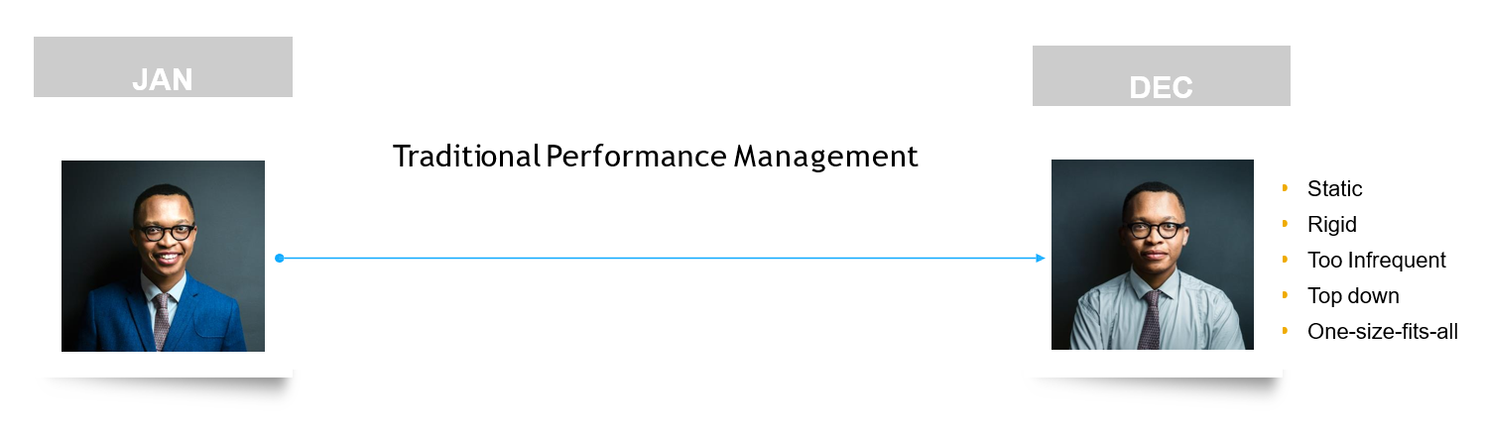
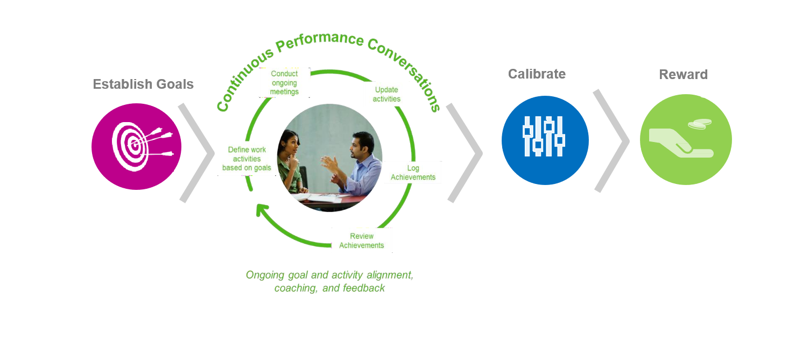
Traditional PM vs Flexible PM approach

Slide 3

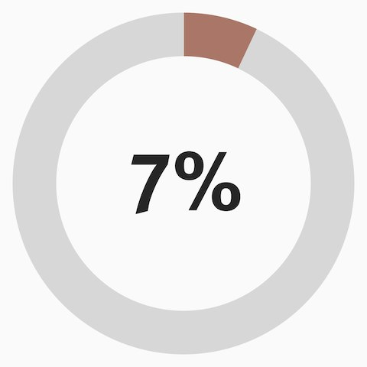
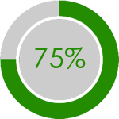
Why Continuous Performance?
Performance Management is Continuous*
*Performance is not something measured once a year.
Current state
Future state

Slide 4
Recommended Practices for continuous conversations
Who will meet? | When | Frequency | Duration | HRBP Presence | What to cover in these meetings?
Team Meeting (Manager and DRs) | Weekly | Once | 30-45 mins | Once a month (Managers to send in invite) | Problem Call outs Support needed from Managers Updates Appreciation/ Celebration
Business Town Hall | Monthly | Once | 1-1.15 hours | Attend all | Major Updates Celebrating Big Successes Addressing Questions Provide Platform to leaders in the organization to showcase work
Manager 1:1 with DR | Fortnightly/ Monthy | Once | 30 minutes | Managers/Employees to call out for any specific needs | Listening out Career Growth Plan Appreciation and Feedback(Mutual) Tap Triggers on Motivation/Demotivation
Skip Meetings (Manager with One Level Down) | Quarterly | Once | 30 -45 minutes | Optional | Listening out Team concerns Visibility for team members and gaining in confidence Address Concerns Take in feedback and improvement Updates Can do in START, STOP, CONTINUE Format for clarity

Slide 5
Let’s Reflect on the current process
How are performance discussions handled today?
What feedback are you getting from managers and employees about your current performance process?
Are you able to track whether manager- employee 1:1s happen?
What do you do in the area of coaching and feedback to drive continual performance improvement and development?
Do employees struggle to write self- assessments at year end?
Do managers have visibility into progress against goals and key achievements when they occur in real time?
How do you ensure employees’ work always aligns to business objectives?
Do you have the ability to capture what’s discussed as part of routine performance conversations?
5
What happens outside of the technology is often what determines whether continuous performance management has an impact

Slide 6
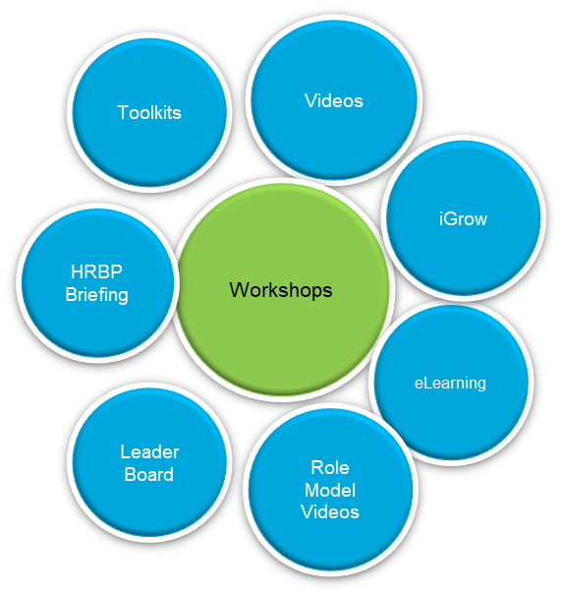
So how do we communicate the value of CPM? Sell it internally to all our employees
Build awareness,
Generate interest,
Educate, prompt and remind employees and managers to have quality conversations,
Regular check-ins and embrace the technology to effectively drive change

Slide 7
CPM Plan Overview
Activity | Description | Approach | Accountability | Audience | Date
Communication | Monthly nudges to create buzz around activation | Email from AATC | Auto TM | All Employees/ People Managers with iGrow access | May
 | Posters to be printed and displayed in different locations | Posters Printed & Displayed in locations with a QR code to access the eLearning module | Auto TM
 | E-mail communication to roll out the eLearning | HR Communication / AATC communication with QR code to access the learning | Group TM
Enablement Sessions | Training sessions on CPM to all employees via the Open calendar | Virtual | Auto TM | All Employees | May - Oct
Mint sessions | Deliver session on feedback and coaching via open calendar | Virtual | Mint Trainers | All Employees/ People Managers | May – Dec
Leader board | Quarterly Leaderboards to track utilization | Email | Auto TM | MD’s/HRBP’s | June- Dec

Slide 8
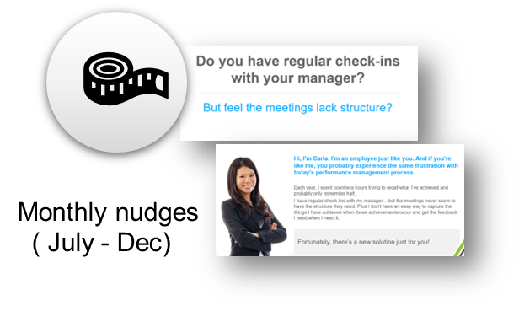

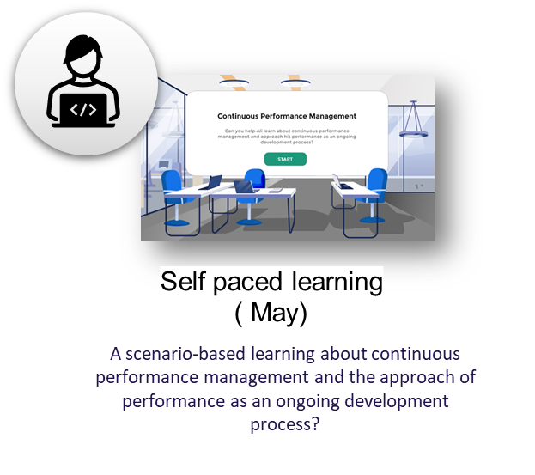


Campaign unpacked- Communication
Activity | Description | Approach | Accountability | Audience | Date
Communication | Monthly nudges to create buzz around activation | Email from AATC | Auto TM | All Employees/ People Managers with iGrow access | May – June
 | Posters to be printed and displayed in different locations | Posters Printed & Displayed in locations with a QR code to access the eLearning module | Auto TM
 | E-mail communication to roll out the eLearning | HR Communication / AATC communication with QR code to access the learning | Group TM
1
2
3
Poster campaigns ( May/June

Slide 9
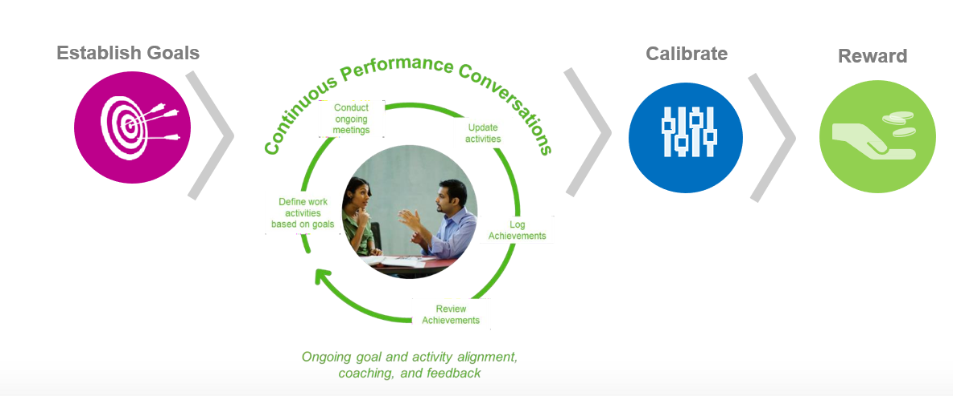
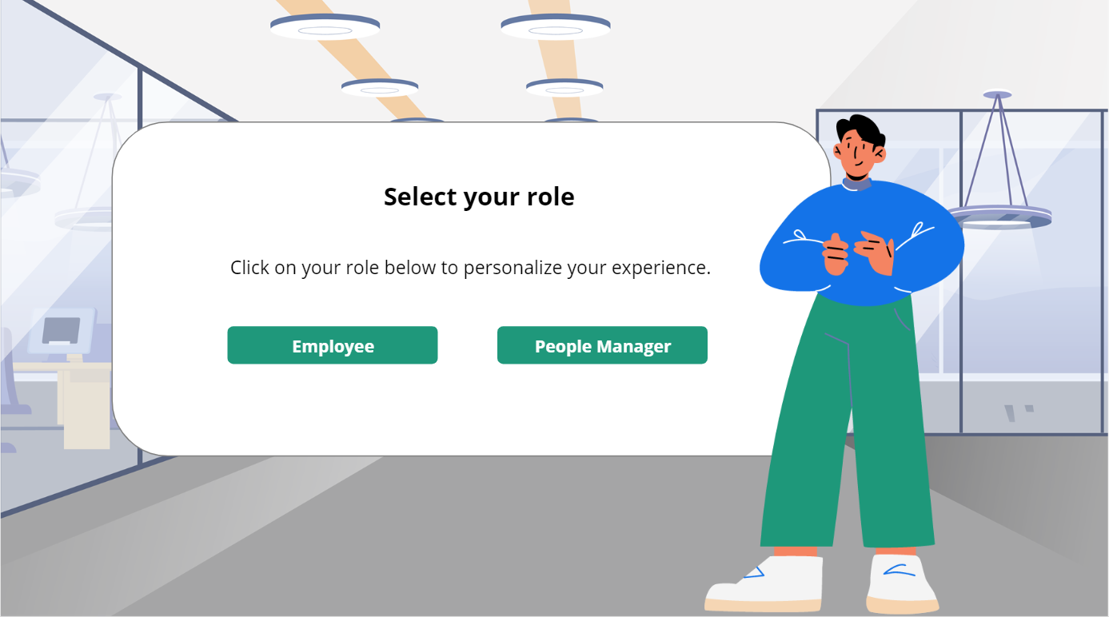
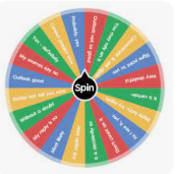
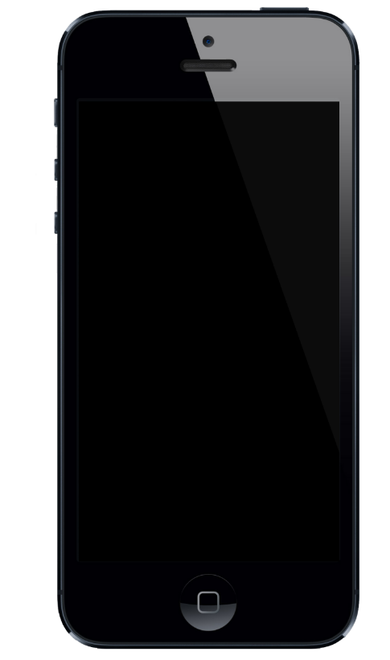

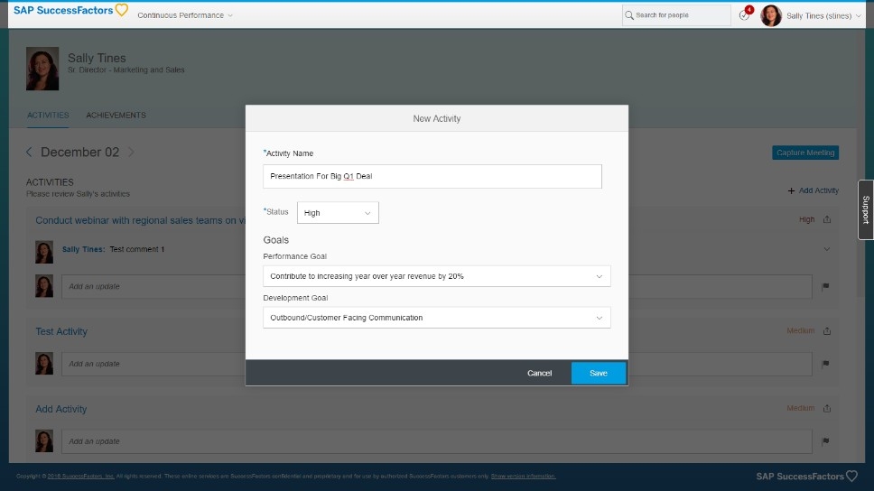
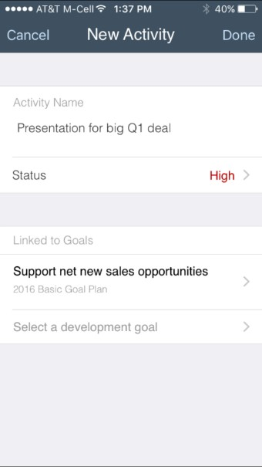
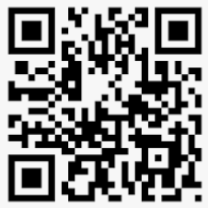
Campaign unpacked- Enablement sessions
Activity | Description | Approach | Accountability | Audience | Date
Enablement Sessions | Training sessions on CPM to all employees via the Open calendar | Virtual | Auto TM | All Employees | May - Oct
4
Session activities
1. Simulation via qr code
2. Quiz on continuous PM
3. Practical application
Virtual sessions including experiential activities*
(June)
An engaging and experiential concept to emphasis the importance of CPM and demonstrate the ability to add their activities , achievements and regular check ins with their employees/ Managers
Bite size sessions that cover the concepts of different conversations, Continuous performance management approaches, performance as an ongoing development process, rather than an annual appraisal process.
* Elearning will be a pre-course that would need to be completed prior to attending the session

Slide 10

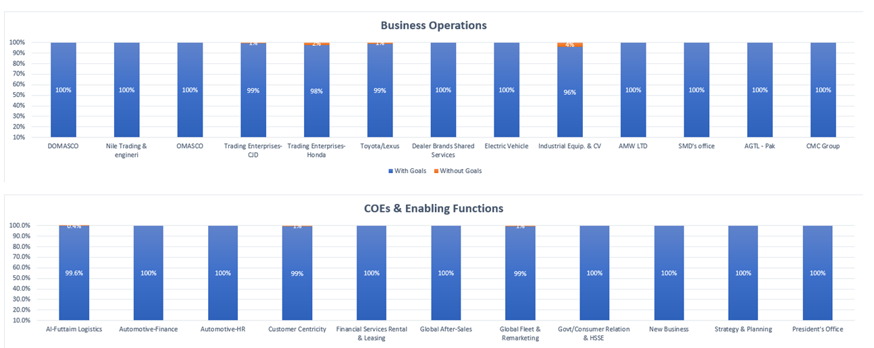
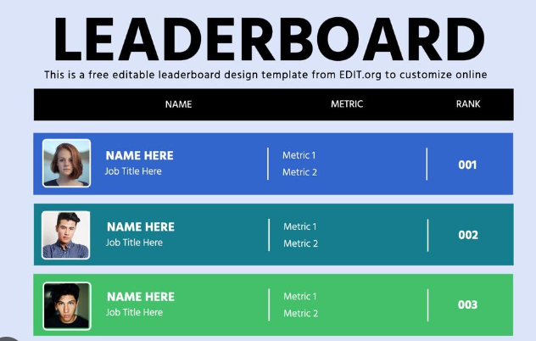
CPM Plan Overview
Activity | Description | Approach | Accountability | Audience | Date
Leader board | Quarterly Leaderboards to track utilization | Email | Auto TM | MD’s/HRBP’s | June- Dec
A monthly/ quarterly dashboard showcasing the utilisation. Audit the quality of activities and achievements logged in the system

Slide 11

Emirati Development campaign/plan

Slide 12
2023 Adoption and Application for Emirati Employees
Strategic focus on enabling all Emirati population within the Automotive Division to have a robust Individual Development Plans to supplement their career growth within the Automotive Division.
May 2023 activities will prioritise adoption of personal growth and career development plans
Offsite/Onsite experiential and seminars will provide a blend of ways to interact and explore the concepts, tools and application of IDP
100% IDP completion rate in Success Factors for current Emirati employees with over 90 days service
Deliver “Personal Growth Frameworks” in-person seminars for Line Managers and Emirati Employees by May 2023.
All employees will leave with a first draft of a plan for follow-up and completion with their Line Manager.
Communications plan; and HRBP support for an impactful initiative
Accessible digital resources for ongoing reference; learning; and support
Interventions through 2023 to check quality of plans and implementation.

Slide 13
Emirati Personal Growth Framework Plan
Activity | Description | Approach | Audience | Date
Communication | Email communication from Kevin/Amr on the rollout of the initiative following the Group communication | Email from AATC /HR Director | All UAE nationals & their Managers | April
 | Teasers as part of the campaign | Email
 | Targeted e-mail communication to roll out the seminars | HR Communication / AATC communication with QR code to access the learning prior to attending the seminar
Enablement sessions | Self paced e-learning module to help employees & people managers develop their IDP. | E-Learning | All UAE nationals | W3 April ( based on Group confirmation)
Enablement sessions | 8 face to face seminars of 3 hour each | Seminars in Innovation Hub & AATC | All UAE Nationals | May: 9, 11, 15, 17, 18, 22, 23, 25
 | Emirati’s Managers sessions : 2 sessions | Virtual | Managers | TBC
Mint sessions | Sessions on Career Success & IDP | Virtual | All Employees/ People Managers | April – May – June
Leader board | Quarterly Leaderboards to track utilization/ audit quality of IDPs | Email | MD’s/HRBP’s | June- Dec
UAE Nationals: 437
Band | C | D | E | F | G | H | I | J
Total emp. | 16 | 28 | 130 | 176 | 61 | 20 | 5 | 1

Slide 14
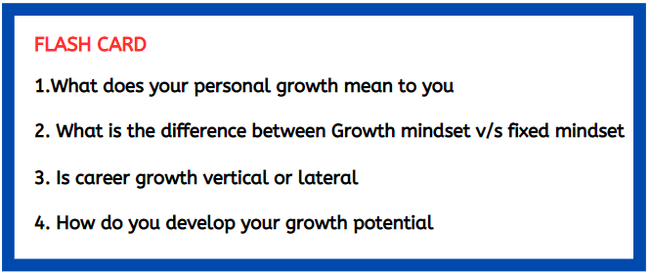

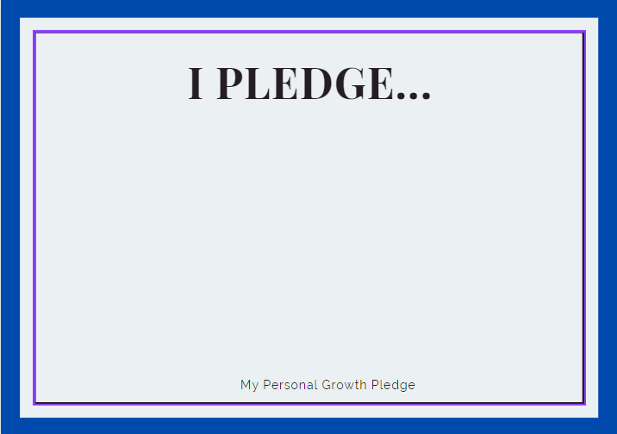
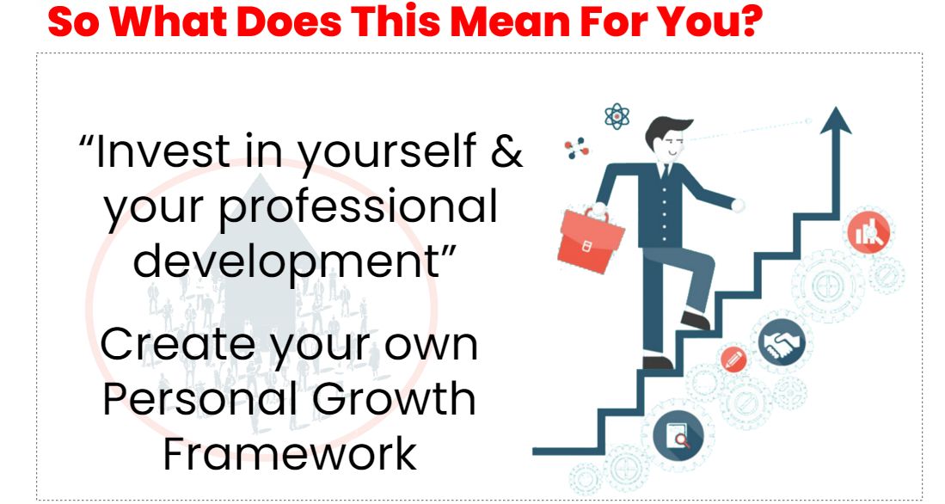

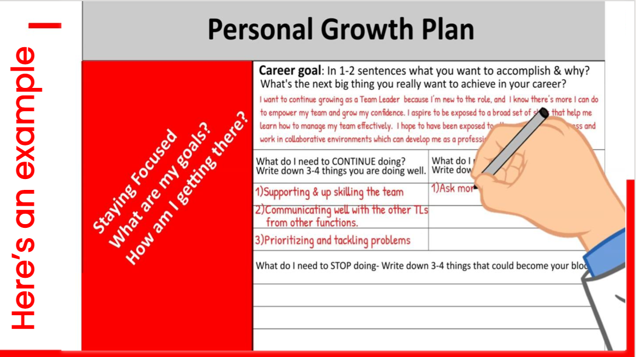
Draft Seminar Agenda
Activity
Welcome | TM team
Icebreaker | TM team
Automotive Strategy | Amr/ Senior Auto leader
EV Strategy | Hasan
Q & A with key speakers | Hasan + Amr + Kevin
Flashcards Questions | Mentimeter
Success stories | By Top performing UAE nationals
Career Timeline exercise | TM team
Developing your Personal Growth Framework | Framework & Exercise(Vision Tree Drawing)
Development Talk | Career Coach
Practical application | Write down at least 2 SMART Development goals
Closing | Group Photo
End | Pledge Cards Photobooth with Props

Slide 15
Emerging Leaders plan

Slide 16
Emerging Leaders rollout by cohorts
Emerging Leader Programme- Band G-H
Approach | Module Title | No of pax | Duration | JUN |  | JUL |  | AUG |  | SEP |  | OCT |  | NOV |  | DEC
Learning Lab | 1. Engaging Leadership | 20 | I day | Cohort 1 | Cohort 2 | Cohort 3 | Cohort 4 | Cohort 5
Learning lab | 2. Goal Driven & Commercial drive |  |  |  |  | Cohort 1 | Cohort 2 | Cohort 3 | Cohort 4 | Cohort 5
Learning lab | 3. Practical coach- Goal Driven |  |  |  |  |  |  | Cohort 1 | Cohort 2 | Cohort 3 | Cohort 4 | Cohort 5
Mentoring session ( band J-K) | Mentoring session | 20 | 2 hrs |  |  |  |  |  |  | Cohort 1 | Cohort 2 | Cohort 3 | Cohort 4 | Cohort 5
Learning lab | 4. Managing complexities ( TBC) | TBC | TBC | TBC |  | TBC |  | TBC |  | TBC |  | TBC |  | TBC |  | TBC | TBC
Next steps
TTT for the Trainers ( External )
Get nominations based on criteria
Communication to the targeted population
Recruit Mentors for the sessions
Track and Monitor completions of the programme
Leadership briefing/connect before the session- Business side and not Corporate
360 forms- launch
Tuesday/Thursday- 2nd or 3rd week

Slide 17
Appendix

Slide 18
There is scope to improve engagement by managers
POSITIVE
FEEDBACK
AREAS TO
IMPROVE
1 Role clarity
2 Collaboration
3 Customer centricity
Excellence
Al Futtaim as a place to work
Manager takes an active interest in my growth and development
Communication
Effort to listen to opinions
Recognition & appreciation
Work life balance
Source: Growing together survey 2022

Slide 19


Two approaches to better manager engagement
CONVERSATIONS
ON-THE-GO
FOCUSED CONVERSATIONS
At any stage of work
Instant feedback
Tied to goals
Appreciation
At fixed intervals
Micro-conversations
Based on set themes
Public recognition
Recorded for follow-up and appraisal

